Slide 1
How to view last year’s appraisal document(s)
(This won’t work if the doctor was revalidated since the last appraisal)

Slide 2
Click on the “Revalidation Date”

Slide 3
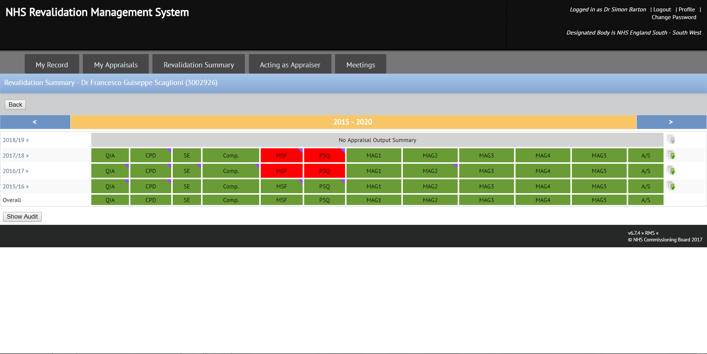
Click on the download icon for the relevant year

Slide 4
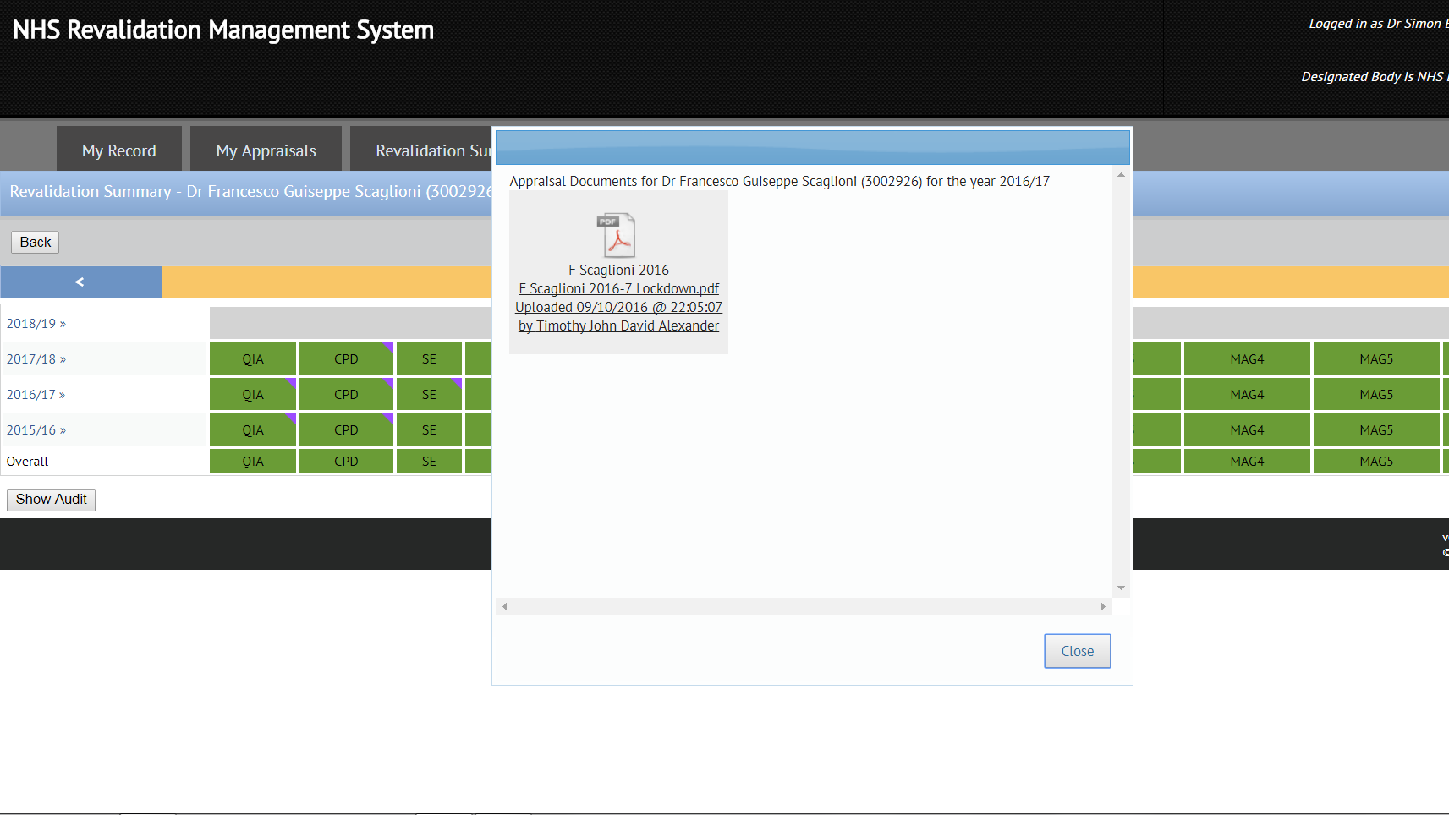
A new window will appear showing the documents pertaining to that year’s appraisal, even if it was a different appraiser.
Click on the chosen document to download it.

